Slide 1
Predicting Housing Prices in Ames Iowa through Machine Learning Techniques
Rajesh Arasada, Yung Chou, Nilesh Patel, Pankaj Sharma, Tim Waterman

Slide 2
Purpose
For Industry: Understand which housing aspects are valued by consumers, in order to accurately price assets, and evaluate undervalued/overvalued assets n the market.
For Consumers: Understand how much they might expect to pay for specific features/aspects of a new home.
Presentation Outline: Visualizing Data Missing Data Feature Selection Data Transformation Linear Models Tree Models KNN

Slide 3
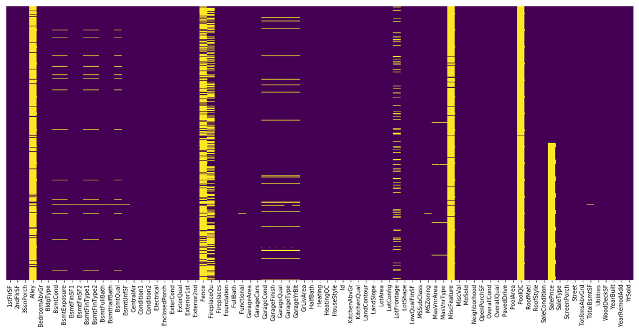
Missingness

Slide 4
Data Cleaning
we drop few unwanted columns, which don't have any impact on sale price. Then we change the data type of the ‘MSSubClass’ features from numeric to string.
Missing Values
Flagging as 'No':
BsmtFinType1, BsmtFinType2, GarageType, GarageFinish
Values are Missing, Because there is no Garage and Basement.
Impute the Mode:
Electrical,Exterior1st, GarageCars, MSZoning, KitchenQual, MasVnrType, SaleType
Impute Zero:
GarageQual, GarageCond, BsmtCond, BsmtExposure, BsmtQual, FireplaceQu
Changing categorical ranking into numerical scale values.
Dummify remaining categorical features.

Slide 5
Features Engineering
Derived Features
Feature:
TotalSF = TotalBsmtSF + GrLivArea + all other areas
TotalBaths = FullBath + BsmtFullBath + .5(HalfBath + BsmtHalfBath)
YearBuilt_Age = 2018 - YearBuilt
Dropping columns which are repeated:
TotalBsmtSF = sum of(BsmtFinSF1, BsmtFinSF2, BsmtUnfSF')
GrLivAre = sum of(1stFlrSF, 2ndFlrSF)
Taking log of ‘SalePrice’
Notes:
Logical ‘committee’ assessment
Dropping variables with uneven distribution of values (i.e. utilities) as add more complexity than predictive value
List out the final selection of our features here

Slide 6
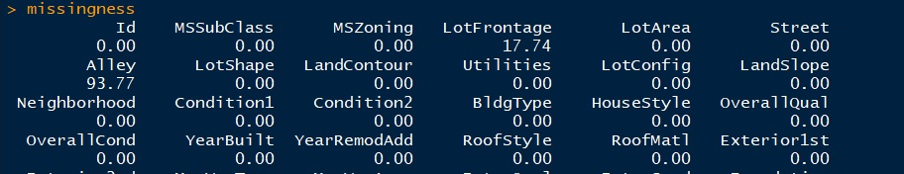
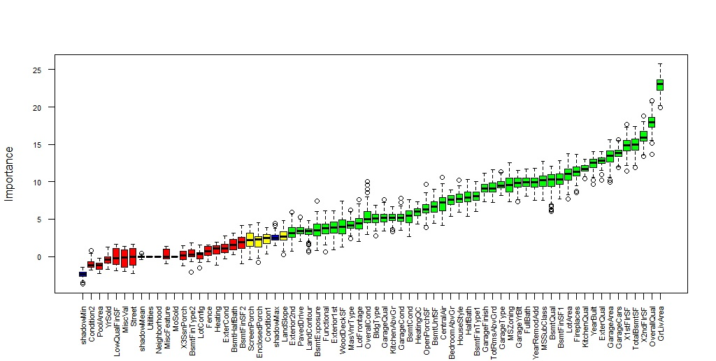
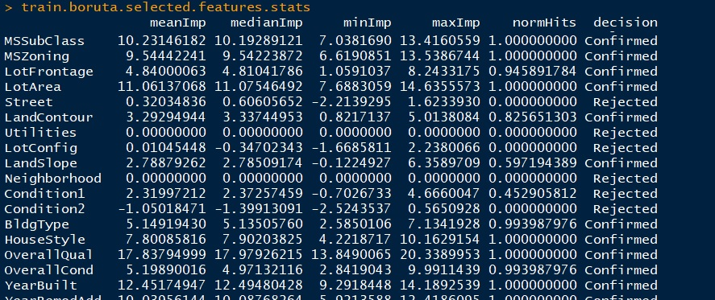
Understanding and visualizing data
Missing values
Boruta as starting point
Random Forest

Slide 7
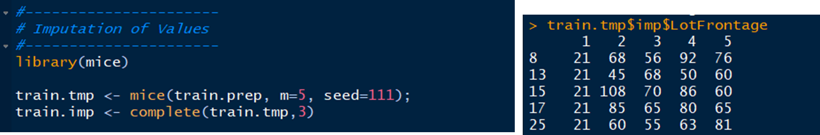
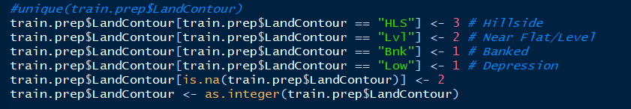

Slide 8
Linear Models
Individual team models, best “crowdsourced” results selected
Multivariable linear models
Ridge
Lasso
Elastic
Plot different values for different attempts by different team members for different models

Slide 9
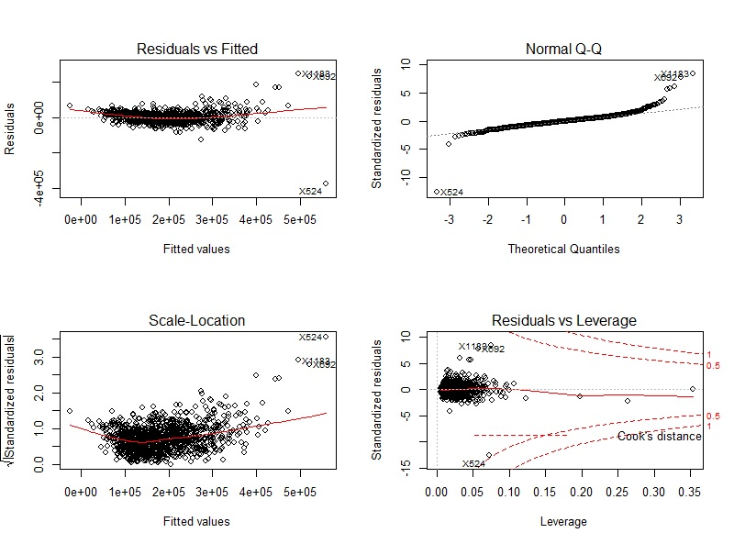
lm

Slide 10
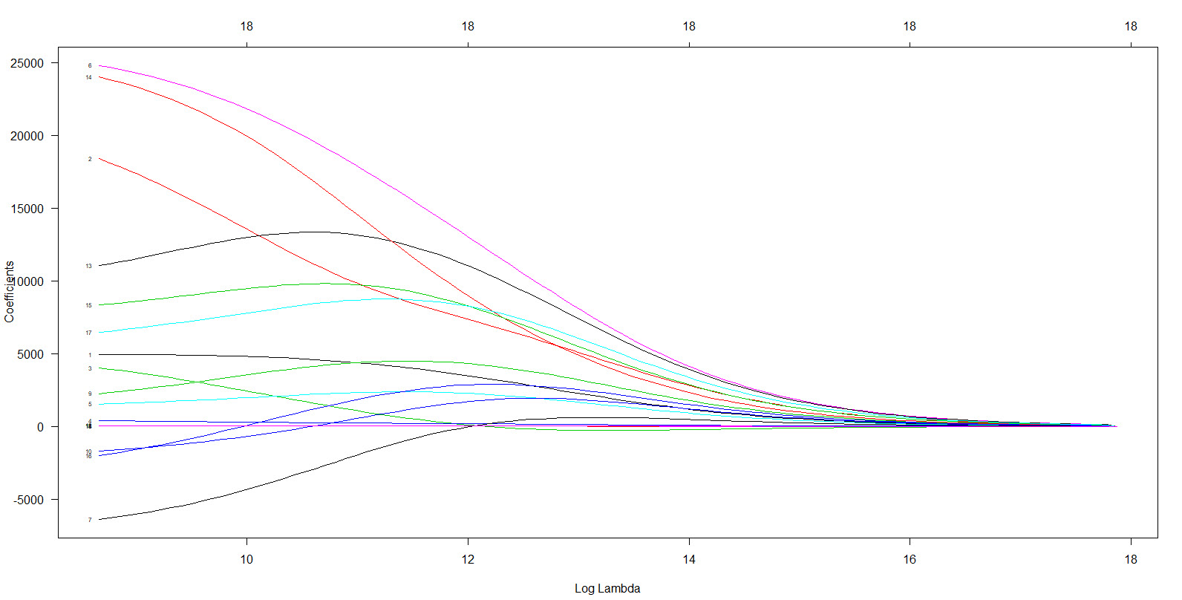
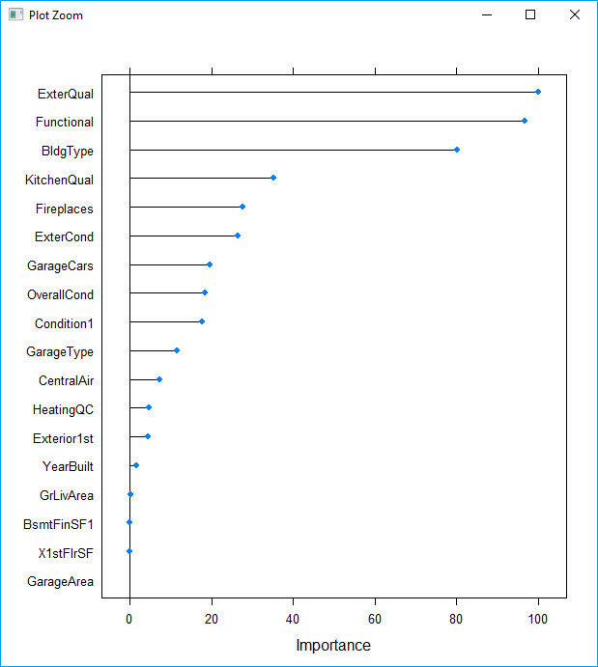
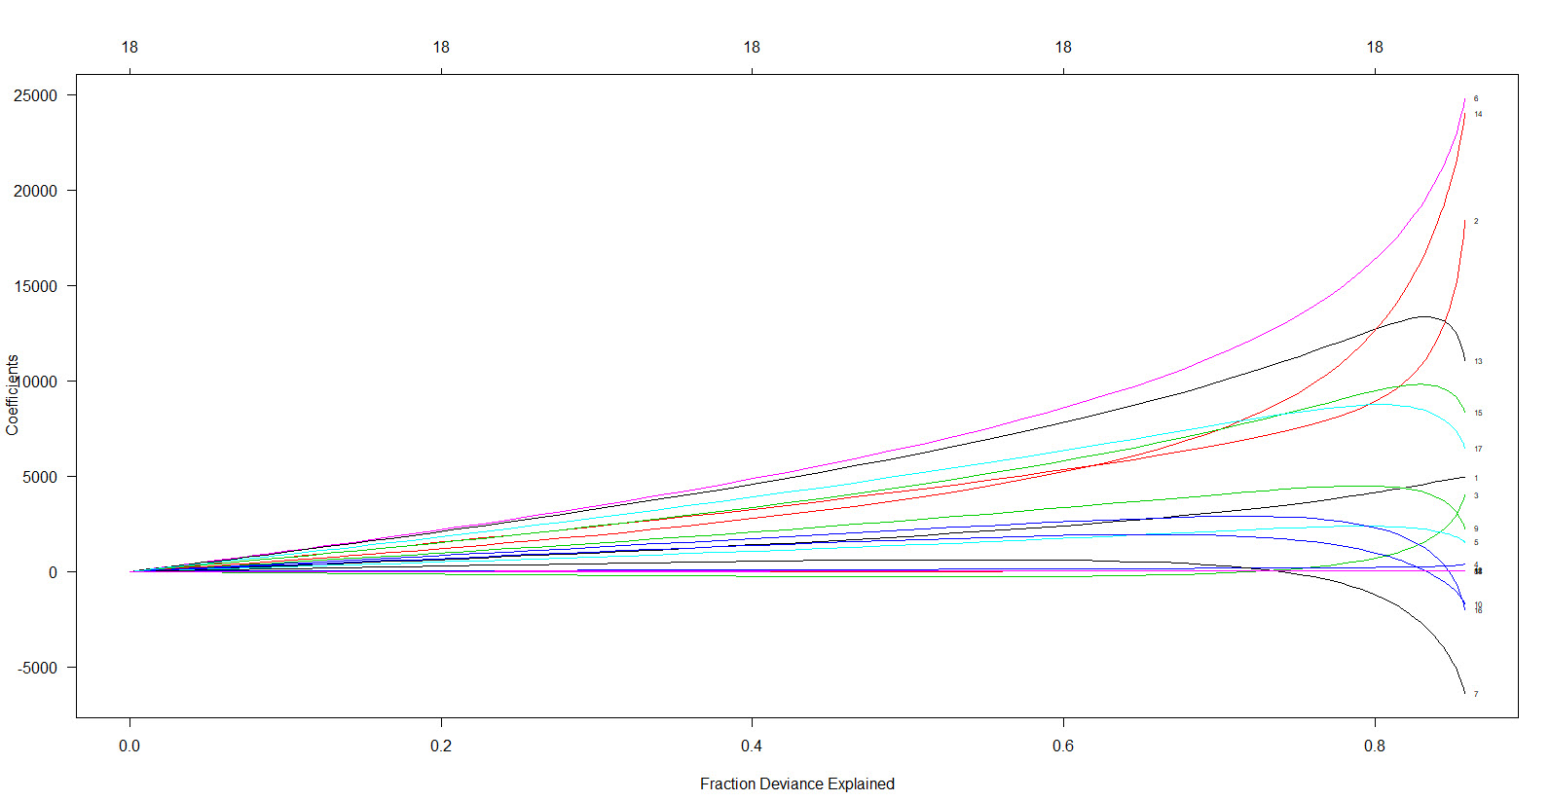
ridge

Slide 11
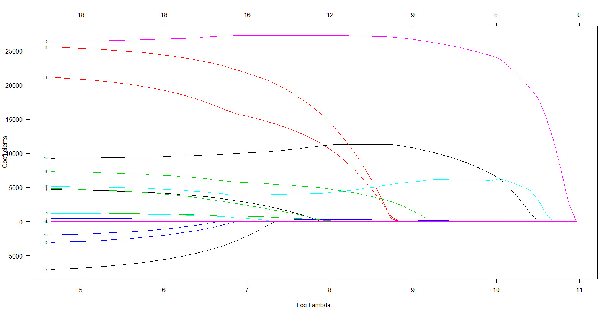
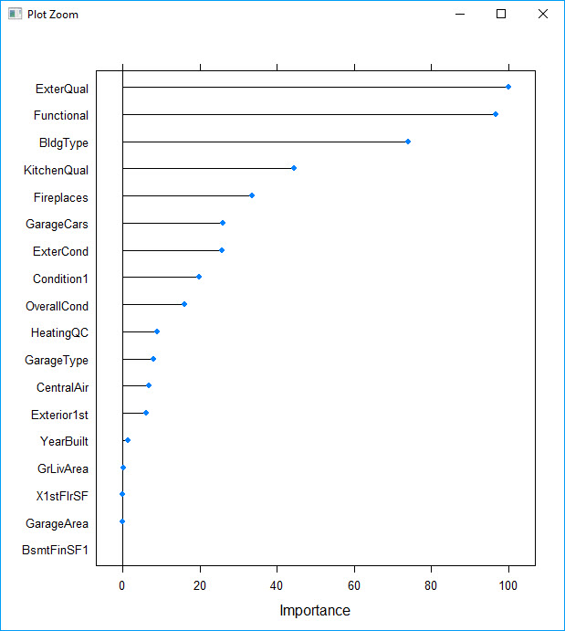
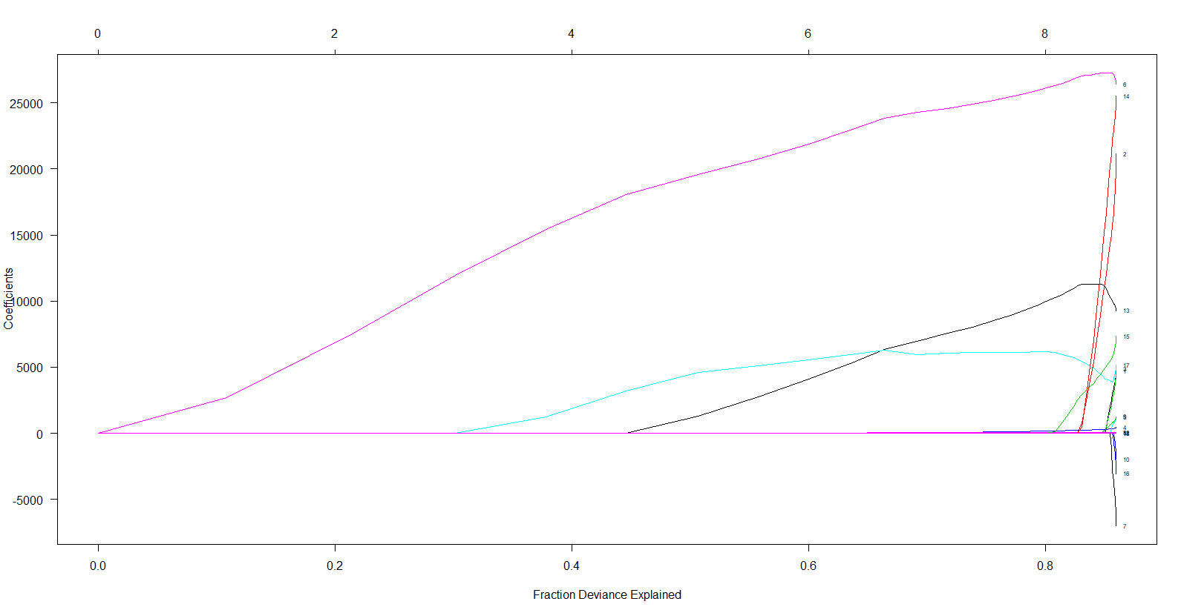
lasso

Slide 12
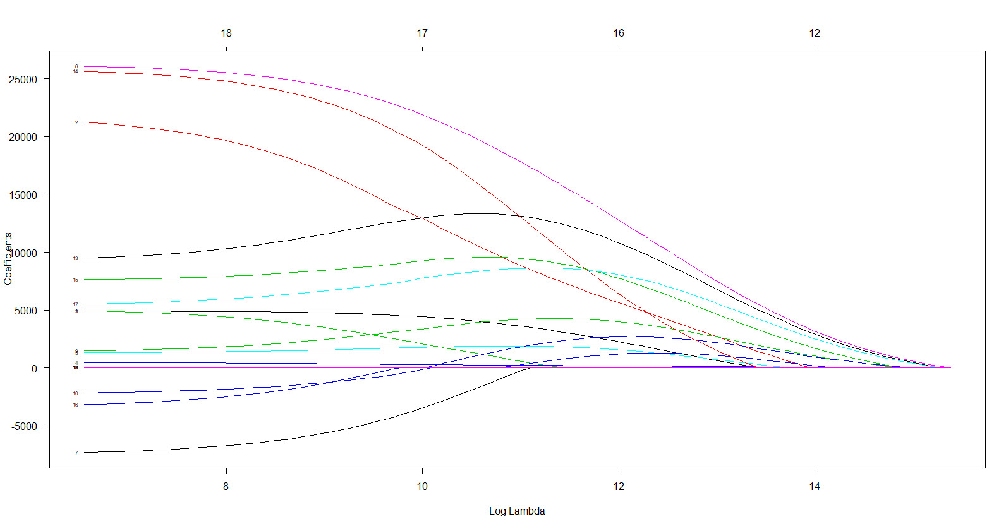

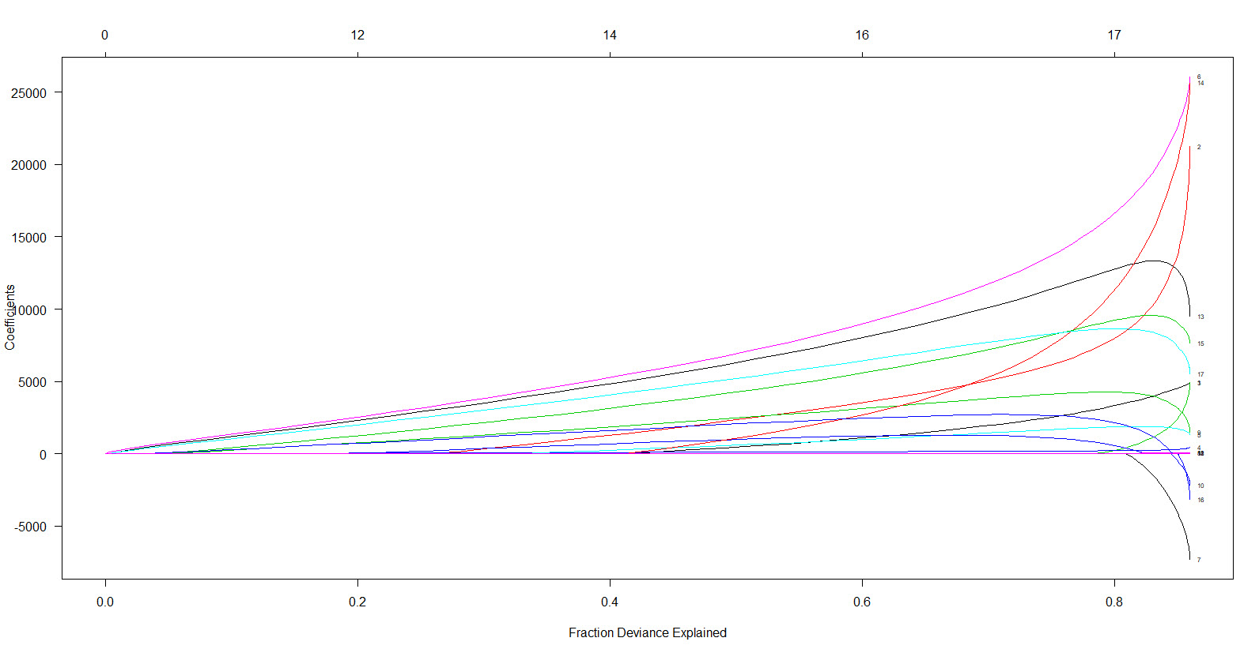
elastic net

Slide 13
Predicting house prices using linear models
LotArea
TotalLivingSpace
Model | RMSE | Comments
Linear Regression | 0.1685 | 49 features, TotalLivingSpace
Linear Regression | 0.1317 | Squared # Bedrooms

Slide 14
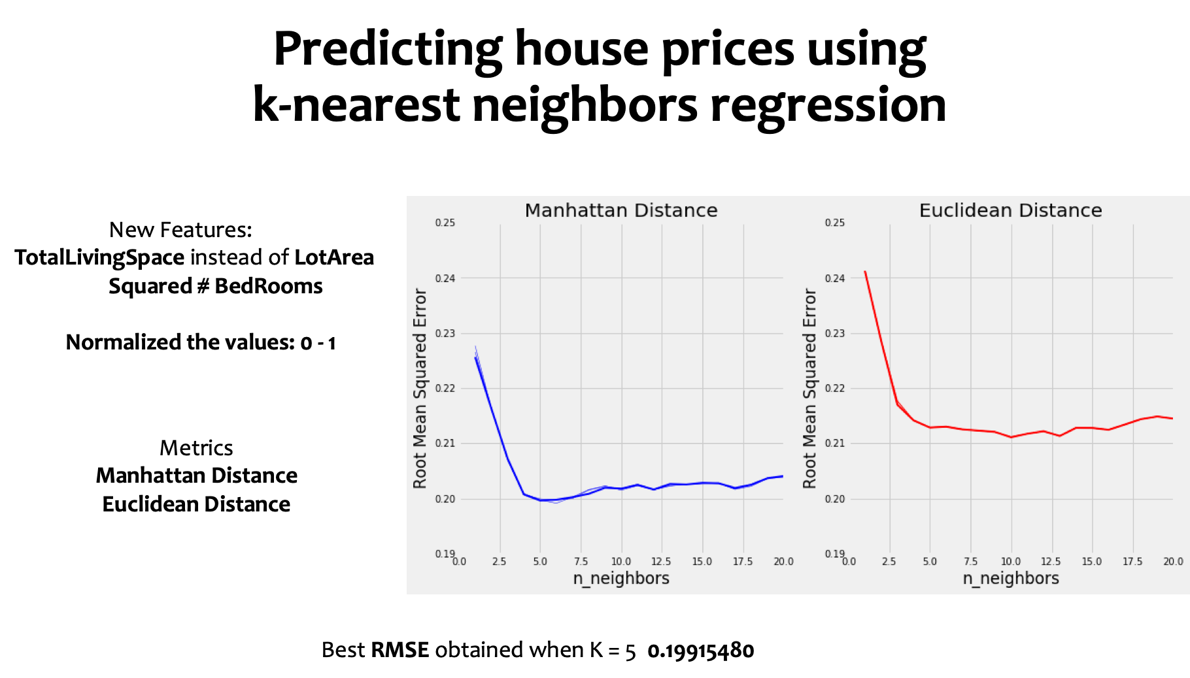

Slide 15
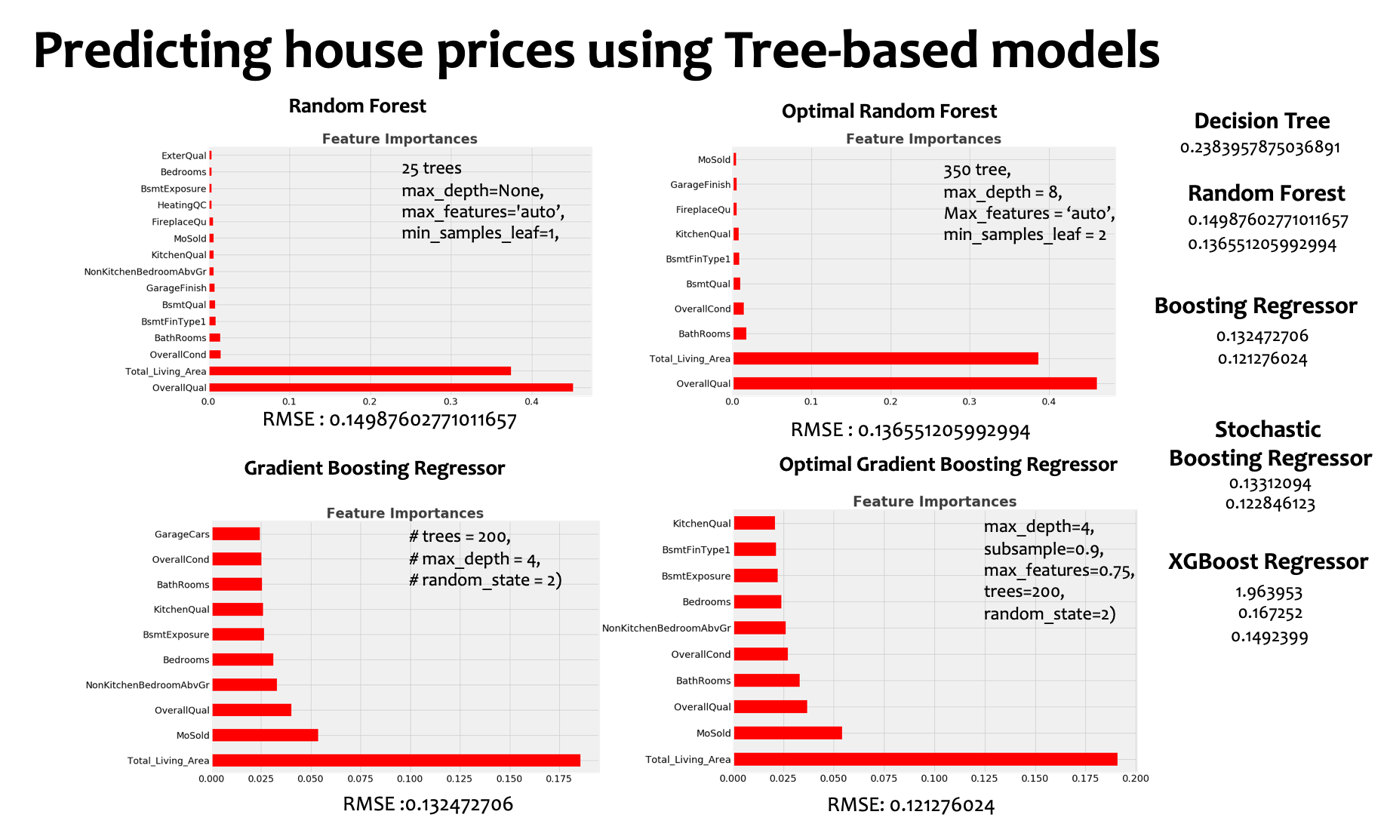

Slide 16


Scores
Linear mode: 014667
Tree-based: 014952

Slide 17
Conclusions and lessons learned
Feature selection is difficult and subjective!
Heart on common sense, mind on statistics
The following features appear to have much influence on a house price:
Total Living Area
External Condition
Month Sold
Overall Quality
For the tree-based models,
Total Living Area
Month Sold
Number of Bathroom
Kitchen Quality

